Slide 1


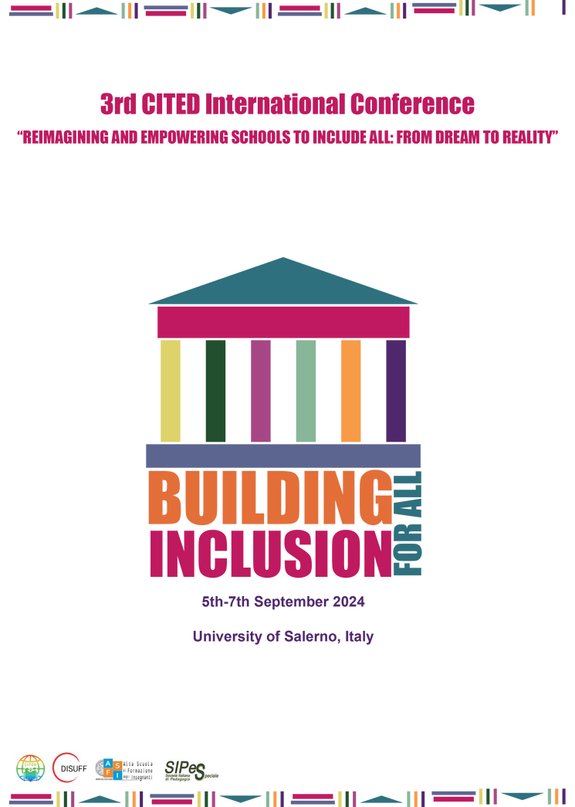



rd
3 International Conference
Consortium of Inclusive Teacher
Education and Development (C.I.T.E.D.)
“REIMAGINING AND EMPOWERING SCHOOLS TO INCLUDE ALL: FROM DREAM TO REALITY”
Lesley Eblie Trudel, PhD - l.eblietrudel@uwinnipeg.ca
University of Winnipeg - CANADA
Roundtable 2:Creating A Positive School Culture
A Systems Change Perspective
5th-6th September 2024
University of Salerno, Italy
Teatro di Ateneo F. Alison
Under the patronage of

Slide 2
Positive Culture and Inclusive Schools
Historical Context
“Regular schools with (an) inclusive orientation are the most effective means of combating discriminatory attitudes, creating welcoming communities, building an inclusive society and achieving education for all; moreover, they provide an effective education to the majority of children and improve the efficiency and ultimately the cost-effectiveness of the entire education system.”
(UNESCO, 1994, p. ix)
Notes:
Historical Context: Thirty years ago the World Conference on Special Needs Education in Salamanca centered discussions on the need for significant reforms in mainstream schools to be able to serve all children and youth (including those with special educational needs). At the conclusion of the conference, it was determined that inclusive education must be integrated into overall educational and social policies in order to be effective. Hence, the “Salamanca Statement” (which you see on this slide) was created and exemplifies not only the elements of inclusive schools but also positive school cultures.

Slide 3
Positive School Culture and Inclusive Schools
Best Practices
In Canada (similar to other jurisdictions) a positive school culture is one which is defined as mutually accepting, inclusive, and equitable.
(Ontario Ministry of Education 2006; Manitoba Education and Early Childhood Learning, 2013)
Notes:
Best Practices: A positive school culture enhances academic achievement (Burdick-Will, 2013; Ramey, 2015). A positive culture is noted as essential for student motivation (Eccles et al., 1993), well-being of children and youth (Ruus et al., 2007; Virtanen et al., 2009) and for improved school attendance (Gottfredson & Gottfredson, 1989). In addition, a positive school culture is associated with reduced school suspension rates (Lee et al, 2011), decreased substance use and improved mental health (LaRusso et al., 2008; Ruus et al., 2007), as well as declines in violent and aggressive behaviours (Karcher, 2002; Gregory et al., 2010).

Slide 4
Positive Culture and Inclusive Schools
Current Trends and Research Priorities
“Equity, Diversity, Inclusion and Intersectionality
Student Discipline, Behaviour and Suspensions
Staff Well-Being in the Education Sector
Notes:
Current Trends: In September 2024, however, school systems across the world continue to fall short of the notions outlined in the Salamanca Statement. School systems continue to miss opportunities to establish positive cultures through inclusive design. In fact segregated programming remains, often in the name of providing targeted supports to learners, with the justification that specialized or separate programs will ensure children get the support they need (as though they may not obtain that support in a more inclusive environment).
A school district in Canada that I’ve been working with over the past six months, is one of these systems. They’ve reached out for assistance to engage in the change process to become more inclusive and accessible. I’ve partnered in a couple of projects with them – one assessing progress relating to equity, diversity, inclusion and intersectionality and another reviewing their school suspension data related to student behaviour. I also research well-being of staff in the education sector and while my recent studies in this school district are not on wellbeing specifically, the nature of my work often intersects with this area. As a result, insights related to well-being naturally emerge and are highlighted in my studies.

Slide 5
Positive Culture and Inclusive Schools
Emerging Insights and Implications
Unified understanding and application of inclusive practices
Equity in resource distribution
Enhanced support for diverse learners
Strengthened initiatives for mental health and well-being
Increased community involvement and engagement
Cultural competency and staff representation
Leadership capacity for equity, diversity and inclusion
Notes:
Emerging Insights and Implications: The contents of this slide reveal the 7 vital elements identified in mixed-methods research studies recently completed in a large Canadian school district. They point to key actions that should be taken to ensure a positive culture and inclusive school organization:
Unified Understanding and Application of Inclusive Practices: Establishing a shared understanding and consistent application of inclusive practices is essential for creating environments where
everyone feels valued and supported, ensuring cohesion across all levels.
Equity in Resource Distribution: Ensuring fair and equitable distribution of resources is critical to addressing disparities and providing all individuals with the tools and opportunities they need
to succeed.
Enhanced Support for Diverse Learners: Tailored support systems for diverse learners are necessary to meet their unique needs and promote their academic and personal growth, fostering a
more inclusive and responsive educational environment (and professional learning for teachers to ensure that they can successfully deliver this support).
Strengthened Initiatives for Mental Health and Well-Being: Expanding and strengthening organizational initiatives that focus on mental health and well-being is crucial to creating a supportive atmosphere that nurtures the holistic development of all.
Increased Community Involvement and Engagement: Greater community involvement and engagement are key to building strong, collaborative relationships that enhance the relevance and impact of decision making.
Cultural Competency and Staff Representation: Promoting cultural competency and increasing staff representation are vital for ensuring that diverse perspectives are respected and reflected in decision-making, contributing to a more inclusive organizational cultures.
Leadership Capacity for Equity, Diversity, and Inclusion: Developing leadership capacity in equity, diversity, and inclusion is essential for leading meaningful change and embedding these
principles into the core values, policies and practices of .

Slide 6
Positive Culture and Inclusive Schools
Future Directions
Research – Inclusive practices in diverse communities
Policy – Regular review and updating
Change – Investment in leadership development
Notes:
Future Directions: The following future directions are identified for consideration based on findings revealed in research studies.
Research on Emerging Topics – Further study is required on the effectiveness of inclusive practices, particularly in diverse and underserved communities, to refine and improve approaches in different contexts; incorporate interdisciplinary approaches and adopt research methods that address current gaps or challenges.
Policy Development - Advocate for policies that mandate regular review and updating of inclusive practices, ensuring alignment with contemporary educational need; ensure that policies are based on evidence from research; work toward outlining strategies that translate research findings into actionable outcomes; emphasize the importance of working closely with community partners to ensure relevance.
Sustaining Change – Invest in leadership development focused on equity, diversity, inclusion and intersectionality, to build capacity for sustained implementation of inclusive policies and practices; efforts should bring about meaningful, transformative change; discuss plans to scale successful initiatives or interventions and continuously monitor and refine strategies to ensure long-term success.

